Slide 1
Internship Studio Final Project Report
Sales Data Analysis and Reporting for a Retail Chain
Mohd Shahnawaz Aadil

Slide 2
Table of Contents
01
Phase 1
02
Phase 2
03
Phase 3
04
Conclusion
Data Collection and Database Setup
Data Cleaning and Preparation
Data Analysis
My conclusion

Slide 3
About me
Hello, I'm Mohd Shahnawaz Aadil, a passionate and ambitious student with a dual focus on data science. Currently, I am immersed in my academic journey, pursuing a BSc in Data Science at the prestigious IIT Madras. The world of data science, with its potential to unlock insights and drive innovation, has captivated my imagination. Simultaneously, I am dedicated to my pursuit of a B.E. in Data Science at Lords Institute of Engineering and Technology, Hyderabad, where I am gaining hands-on experience and building a strong foundation in this dynamic field.

Slide 4
01
Phase 1
Data Collection and Database Setup

Slide 5
Data Collection
Here I downloaded the data
Retail_Data_Transactions.csv
Retail_Data_Response.csv
from Kaggle as a csv file and placed it in the MySQL workbench Folder.

Slide 6
Database Setup
Section 1: Database Creation and Table Definition
-- Creating the RetailSalesData database
CREATE database RetailSalesData;
USE RetailSalesData;
-- Creating Sales_Data_Transactions table
CREATE TABLE Sales_Data_Transactions (
Customer_id VARCHAR(255),
Trans_date VARCHAR(255),
Trans_amount INT);
-- Dropping Sales_Data_Transactions table (for illustration, optional)
DROP TABLE Sales_Data_Transactions
-- Creating Sales_Data_Response table
CREATE TABLE Sales_Data_Response(
Customer _id VARCHAR(255) PRIMARY KEY,
response INT);
Explanation:
In this section, we start by creating a new database named RetailSalesData.
We create two tables: Sales_Data_Transactions to store transaction data and Sales_Data_Response for response data.
The Customer_id field is a common identifier between the two tables.

Slide 7
Database Setup
Section 2: Data Loading
-- Loading data into Sales_Data_Transactions table
LOAD DATA INFILE ‘C:/ProgramData/MySQL/MySQL Server 8.0/Uploads/Retail_Data_Transactions.csv’
INTO TABLE Sales_Data_Transactions
FIELDS terminated by ‘,’
LINES terminated by ‘\n’
IGNORE 1 ROWS;
Explanation:
This section involves loading data from an external CSV file (Retail_Data_Transactions.csv) into the Sales_Data_Transactions table.
The FIELDS TERMINATED BY ',' and LINES TERMINATED BY '\n' specify the CSV format.
Section 3: Query Explanation and Optimization
-- Explain plan for a SELECT query
EXPLAIN SELECT * FROM Sales_Data_Transactions WHERE CUSTOMER_ID= ‘CS5295’;
-- Creating an index on Customer_id for optimization
CREATE INDEX idx_id ON Sales_Data_Transactions(CUSTOMER_ID);
-- Explain plan for the SELECT query after index creation
EXPLAIN SELECT * FROM Sales_Data_Transactions WHERE CUSTOMER_ID= ‘CS5295’;
Explanation:
The first EXPLAIN statement is used to analyze the execution plan of a SELECT query without any indexes.
The second statement creates an index (idx_id) on the Customer_id column for optimization.
The third EXPLAIN statement is used to analyze the execution plan after the index is created.

Slide 8
02
Phase 2
Data Cleaning and Preparation

Slide 9
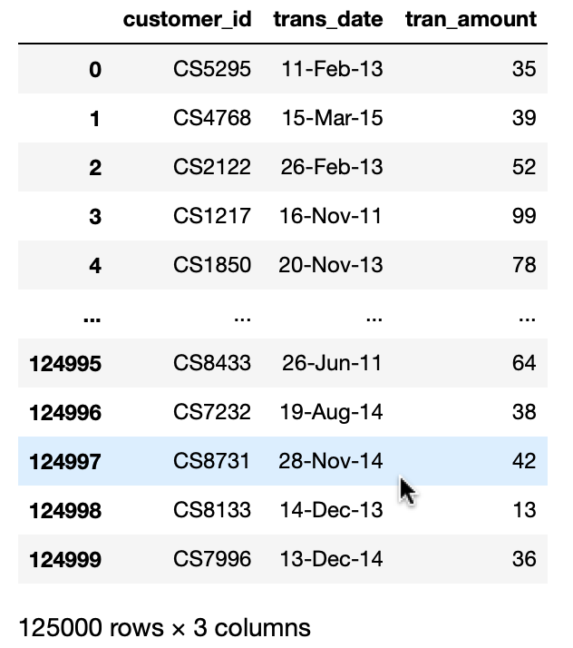
Data Cleaning
# Importing necessary libraries
import pandas as pd
# Reading transaction data
trxn = pd.read_csv('Retail_Data_Transactions.csv')
# Reading response data
response = pd.read_csv('Retail_Data_Response.csv')
# Merging dataframes on 'customer_id'
df = trxn.merge(response, on='customer_id', how='left')
# Handling missing values
df = df.dropna()
# Converting data types
df['trans_date'] = pd.to_datetime(df['trans_date'])
df['response'] = df['response'].astype('int64')
# Adding a 'month' column
df['month'] = df['trans_date'].dt.month
Explanation:
Importing necessary libraries and reading transaction and response data.
Merging dataframes based on 'customer_id'.
Handling missing values and converting data types.
Adding a 'month' column to the dataframe.

Slide 10
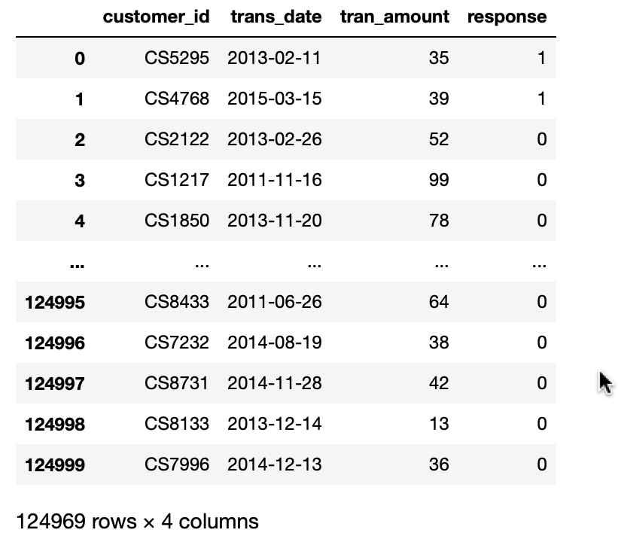
Data Preparation
# Exploring data types, shapes, and tail of the dataframe
df.dtypes
df.shape
df.tail()
# Checking for null values
df.isnull().sum()
# Removing null values
df = df.dropna()
Explanation:
Examining data types, shape, and the tail of the dataframe.
Checking for and handling null values.

Slide 11
03
Phase 3
Data Analysis

Slide 12
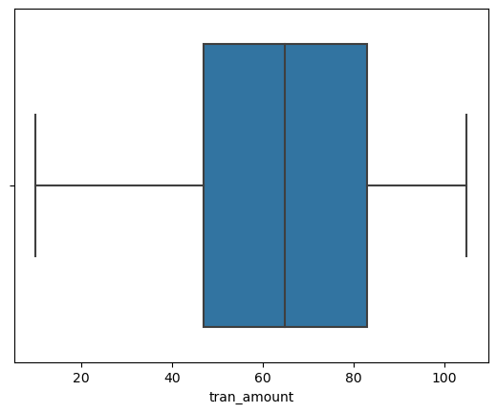
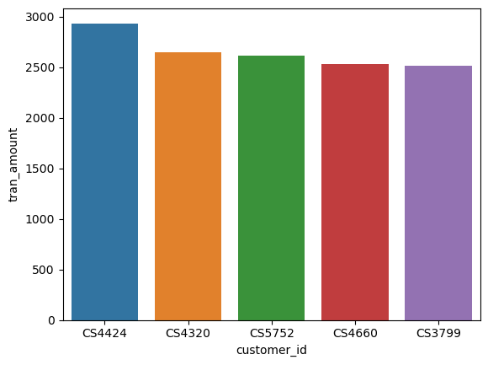
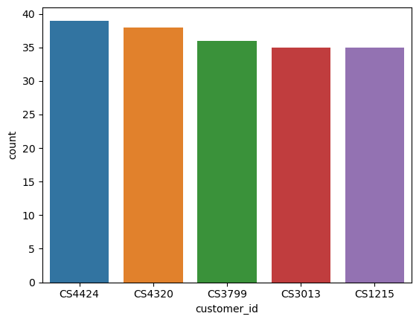
Data Exploration
# Descriptive statistics
df.describe()
# Checking for outliers using Z-scores
z_scores = np.abs(stats.zscore(df['tran_amount']))
outliers = z_scores > threshold
print(df[outliers])
# Visualizing data using boxplot and barplot
sns.boxplot(x=df['tran_amount'])
sns.barplot(x='customer_id', y='count', data=top_5_cus)
sns.barplot(x='customer_id', y='tran_amount', data=top_5_sal)
# Visualizing monthly sales
plt.plot(monthly_sales.index, monthly_sales.values)
Explanation:
Descriptive statistics, checking for outliers using Z-scores, and visualization.

Slide 13
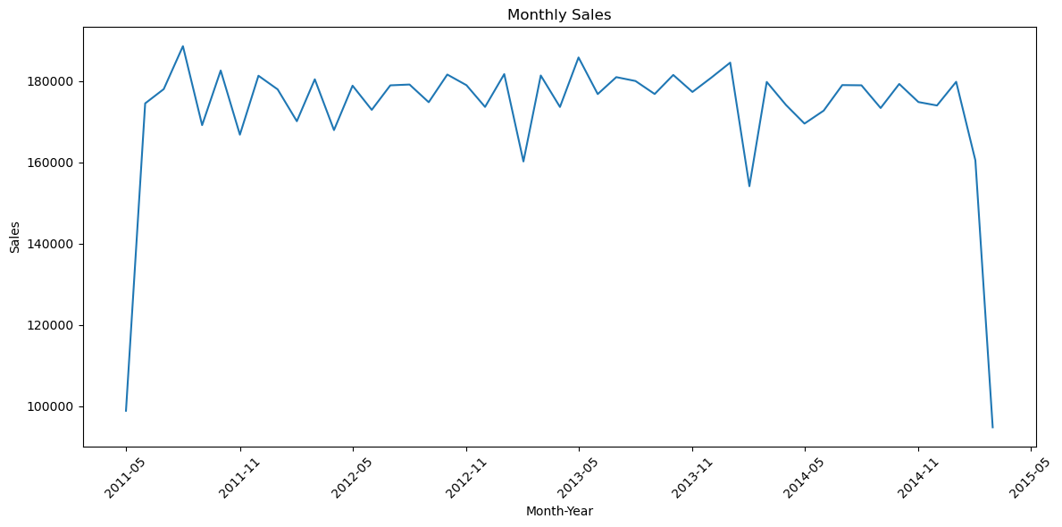
Advanced Analysis
# Grouping by month and summing transaction amounts
monthly_Sales = df.groupby('month')['tran_amount'].sum()
# Analyzing customer counts, top 5 customers, and top 5 customers' sales
customer_counts = df['customer_id'].value_counts().reset_index()
top_5_cus = customer_counts.sort_values(by='count', ascending=False).head(5)
customer_sales = df.groupby('customer_id')['tran_amount'].sum().reset_index()
top_5_sal = customer_sales.sort_values(by='tran_amount', ascending=False).head(5)
# Creating a time-series plot for monthly sales
df['month_year'] = df['trans_date'].dt.to_period('M')
monthly_sales = df.groupby('month_year')['tran_amount'].sum()
plt.plot(monthly_sales.index, monthly_sales.values)
Explanation:
Advanced analysis includes monthly sales, customer counts, top 5 customers, and top 5 customers' sales.

Slide 14
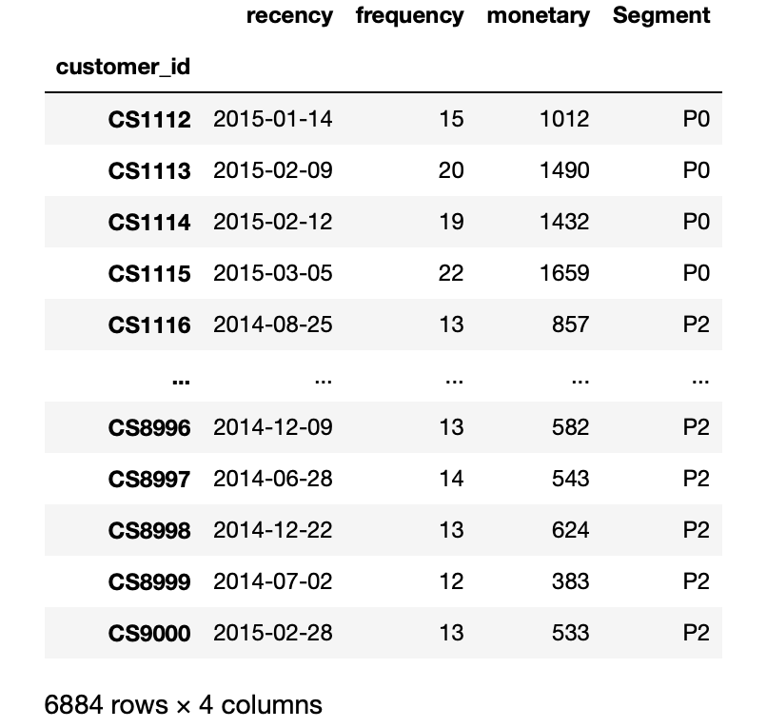
Advanced Analysis
# Creating Recency-Frequency-Monetary (RFM) segments
recency = df.groupby('customer_id')['trans_date'].max()
frequency = df.groupby('customer_id')['trans_date'].count()
monetary = df.groupby('customer_id')['tran_amount'].sum()
rfm = pd.DataFrame({'recency': recency, 'frequency': frequency, 'monetary': monetary})
# Creating segments based on recency, frequency, and monetary
rfm['Segment'] = rfm.apply(segment_customer, axis=1)
Explanation:
Creating Recency-Frequency-Monetary (RFM) segments based on customer behavior.
Defining customer segments 'P0' and 'P2' based on RFM criteria.

Slide 15
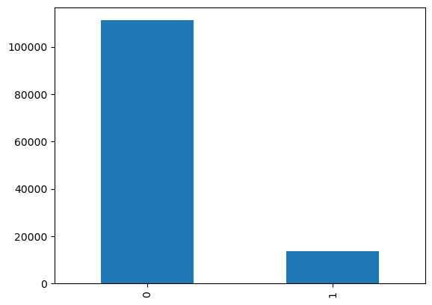
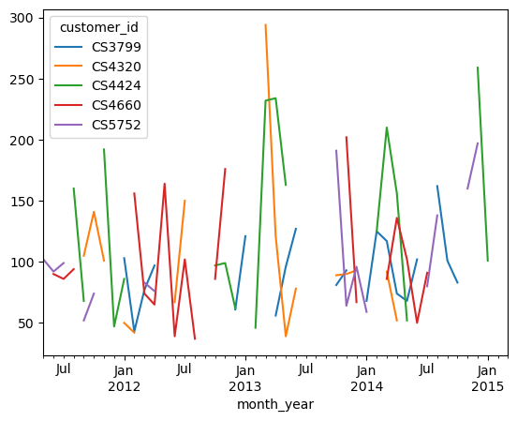
Advanced Analysis
# Additional steps like plotting a bar chart for customer segments and checking response distribution
set(rfm['Segment'])
churn_counts = df['response'].value_counts()
churn_counts.plot(kind='bar')
# Exploring top 5 customers and their sales over time
top_5_customers = monetary.sort_values(ascending=False).head(5).index
top_customers_df = df[df['customer_id'].isin(top_5_customers)]
top_customers_sales = top_customers_df.groupby(['customer_id', 'month_year'])['tran_amount'].sum().unstack(level=0)
top_customers_sales.plot(kind='line')
# Saving cleaned and analyzed dataframes to CSV files
df.to_csv('MainData.csv')
rfm.to_csv('AddAnlys.csv')
Explanation:
Additional steps include plotting a bar chart for customer segments, checking response distribution, exploring top 5 customers, and saving cleaned and analyzed dataframes to CSV files.

Slide 16
My Conclusion
In conclusion, the data science internship project focused on analyzing retail sales data has provided valuable insights into the underlying patterns and trends within the dataset. Through a systematic approach encompassing data cleaning, preparation, exploratory data analysis (EDA), and advanced analytics, we were able to extract meaningful information that can contribute to informed decision-making.
Key Findings:
- Data Quality Enhancement: The process of cleaning and preparing the data ensured a high level of quality, addressing missing values and outliers.
- Exploratory Data Analysis (EDA): Our exploratory analysis uncovered significant patterns in sales data, offering a comprehensive understanding of customer behaviors, top-performing products, and notable trends over time.
- Advanced Analytics: The application of advanced analytics, including segmentation and clustering, allowed us to identify distinct customer segments and unveil hidden patterns that might not be apparent through traditional analysis.
Acknowledgments:
I extend our gratitude to Internship studio for their guidance and support throughout this internship. Their expertise played a pivotal role in the success of this project.
This internship has been a rich learning experience, and the acquired skills and knowledge will undoubtedly contribute to future data science endeavors. We look forward to applying these insights to address complex challenges and drive positive outcomes in the realm of data-driven decision-making.

